Slide 1



2011 Network Solution Introduction
Regional Manager
Ethan Tai
International Business Dept. October 2011

Slide 2
Agenda
1
About DrayTek
2
Our Latest Project & Award
3
Product Roadmap
4
Residential / SOHO Solutions
5
SMB Networking Solutions
6
Enterprise Networking Solutions
7
Network Management System
8
Q & A

Slide 3
1.About DrayTek

Slide 4



About DrayTek
Founded in 1997
Mission
-To create superior network product
Positioning
-Leading network provider of '‘ SMB '‘ class
broadband router solutions delivering
-High Reliability
-High Security
-High Performance

Slide 5
About DrayTek (cont.)
Head Office & Production facilities based in
Hsin-Chu, Taiwan
Branches in Shang-Hai & Germany
Successfully went to TSEC
(Taiwan Stock Exchange Corporation)
An ISO9001 certified & ISO 14001 WEEE/ RoHS / EuP-committed corporation

Slide 6
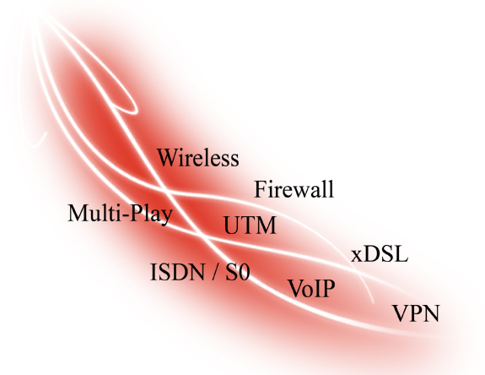
About DrayTek (cont.)
DrayTek Strength
In-house software development
Value Added
Product differentiation
Flexibility of customization
Innovation source driven

Slide 7
2. Our Latest Project & Award

Slide 8
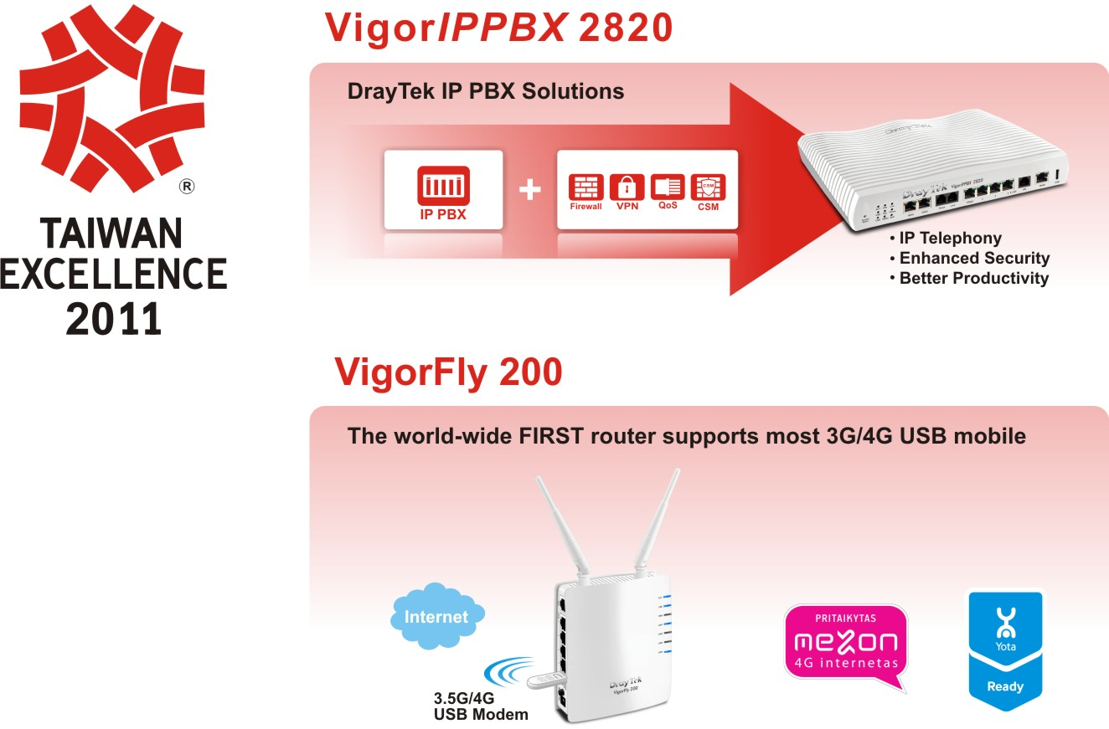
The 19th Taiwan Excellence:
VigorIPPBX 2820 and VigorFly 200
Notes:
8
8
8
8

Slide 9
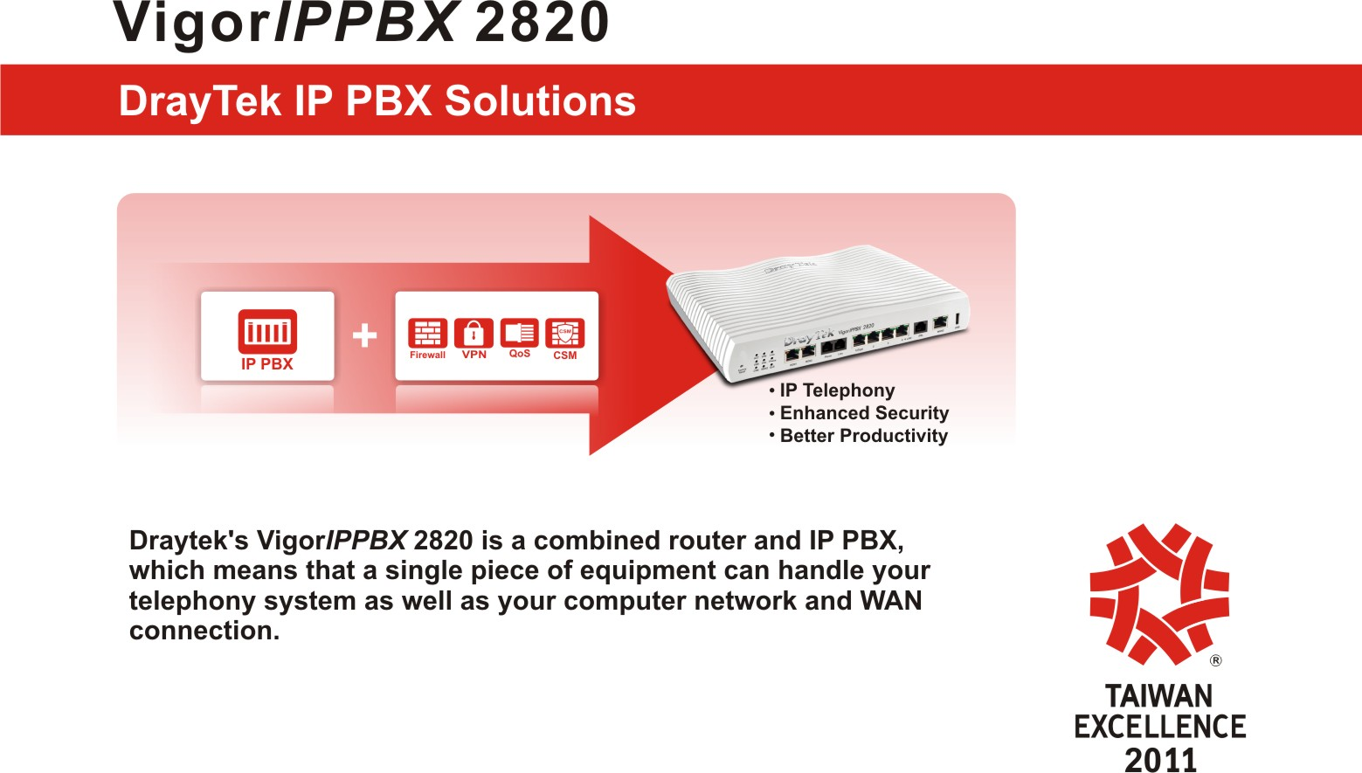
The 19th Taiwan Excellence:
VigorIPPBX 2820 and VigorFly 200
Notes:
9
9
9
9

Slide 10
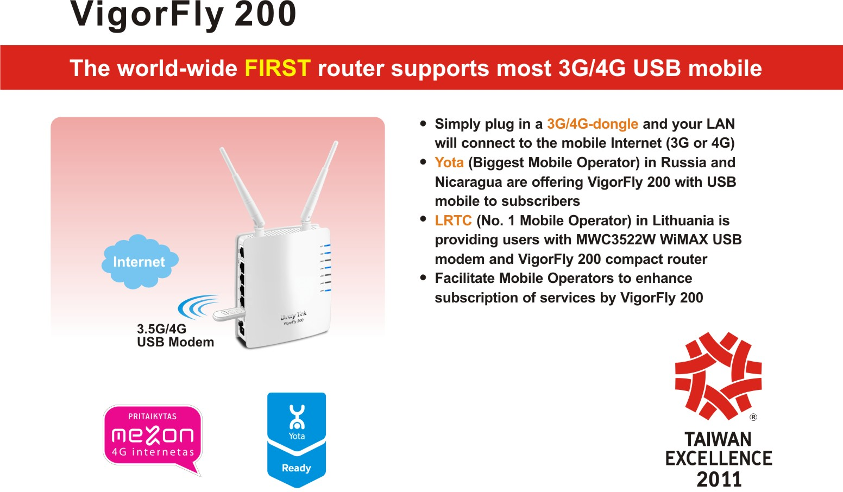
The 19th Taiwan Excellence:
VigorIPPBX 2820 and VigorFly 200
Notes:
10
10
10
10

Slide 11

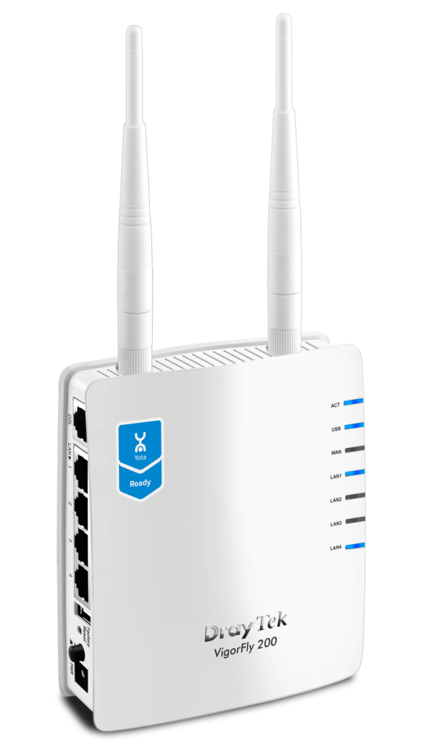
Yota Russia & DrayTek
Notes:
11
11
11

Slide 12
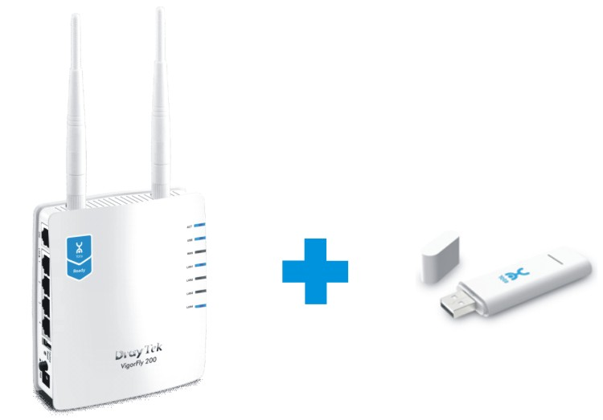

Yota Nicaragua & DrayTek
Notes:
12
12
12

Slide 13


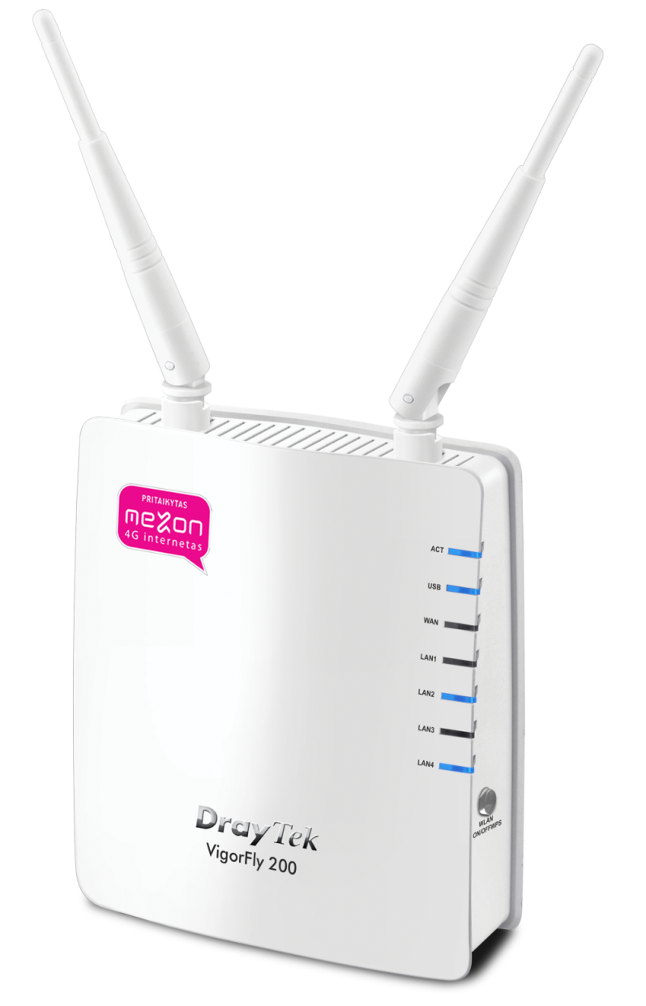
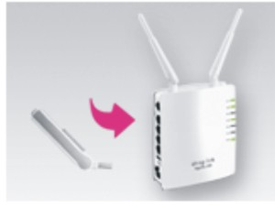

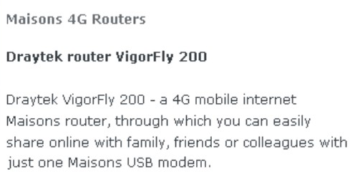
LRTC in Lithuania
Notes:
13
13
13

Slide 14


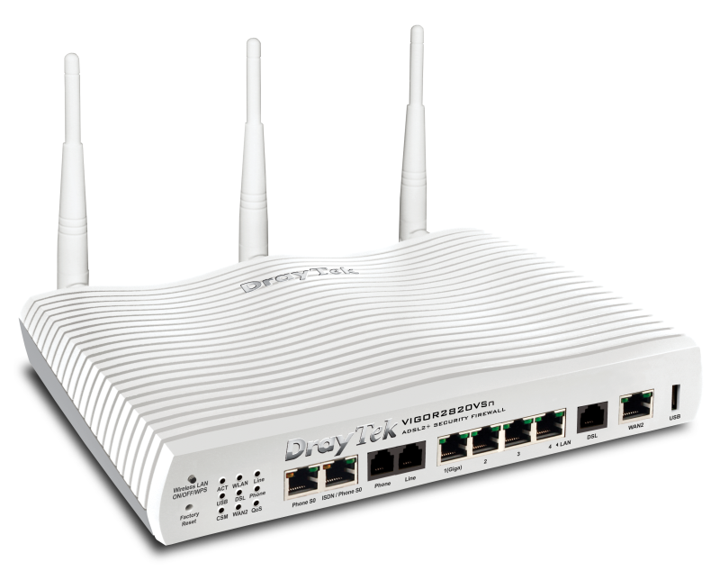
BT & DrayTek
Notes:
14
14
14

Slide 15

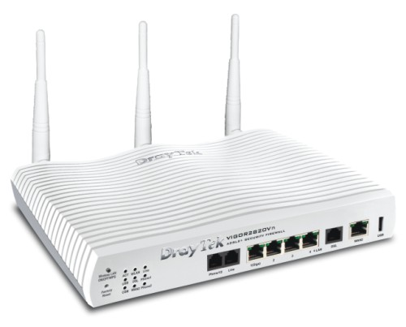


Vodafone
Vigor
Vodafone Huawei K4505
Vigor2820 series for Vodafone
Notes:
15
15
15
15

Slide 16
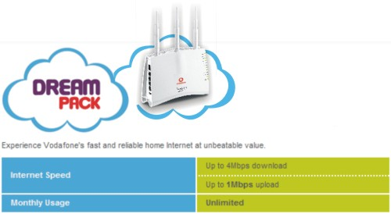
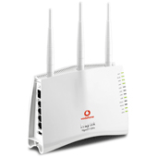
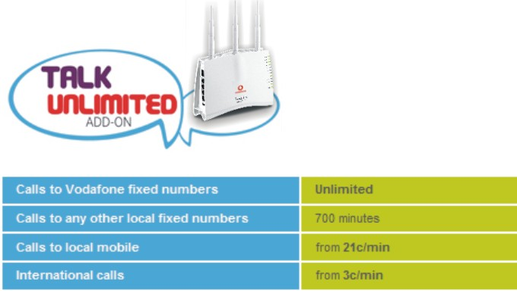
Vodafone
Vigor2110 series for Vodafone
Vigor
Notes:
16
16
16

Slide 17

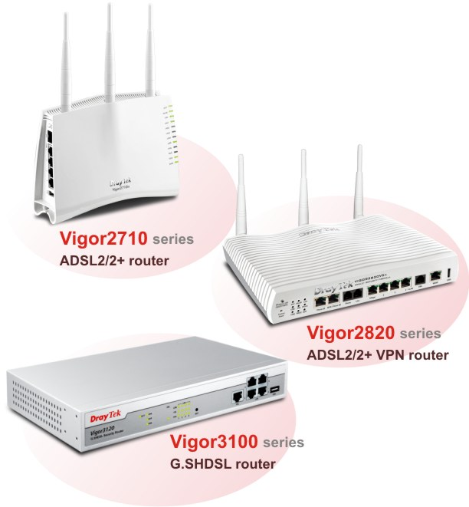
ADD-ON & DrayTek
Notes:
17
17
17

Slide 18

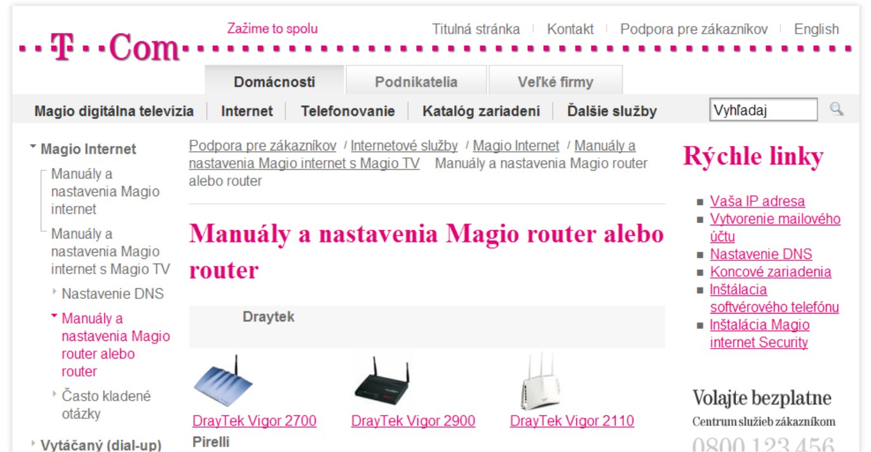
T-com & DrayTek
T-com use DrayTek Vigor2700, Vigor2900, Vigor2110
for IPTV (Magio) services solutions.
Notes:
18
18
18

Slide 19


Solnet & DrayTek
Vigor2700Gi
Notes:
19
19
19

Slide 20

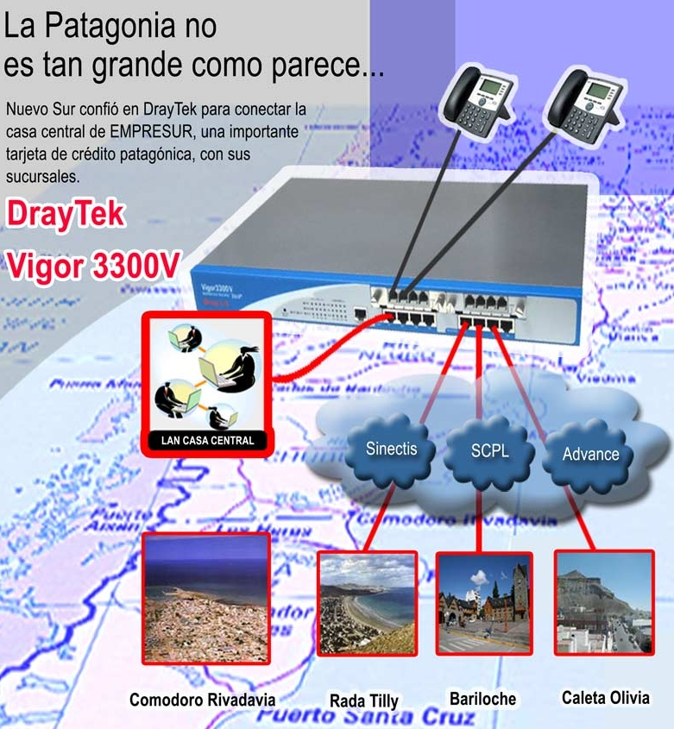
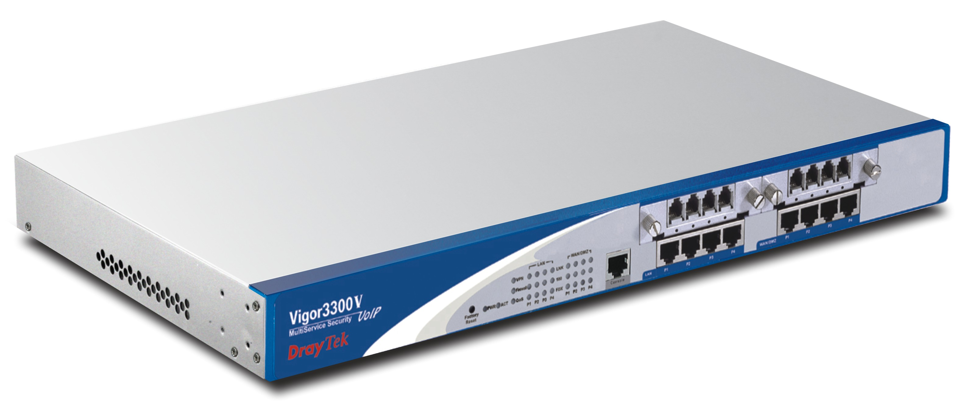
Tecno-network in Argentina
Vigor3300V : Load balance for bank
Vigor3300V
Notes:
20
20
20

Slide 21

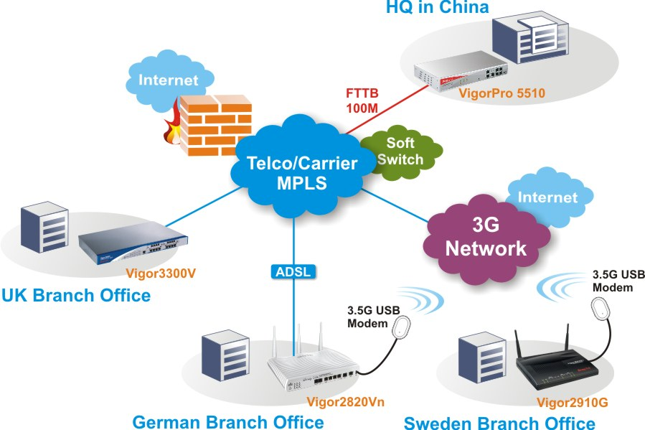
Chunghwa Telecom in Taiwan
EZ VPN Solution
For more information, please see http://en.twgate.net/files/15-1003-313,c68-1.php
Notes:
21
21
21

Slide 22
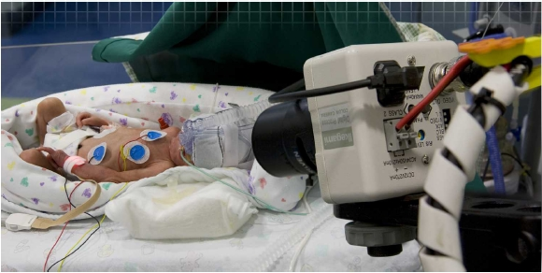
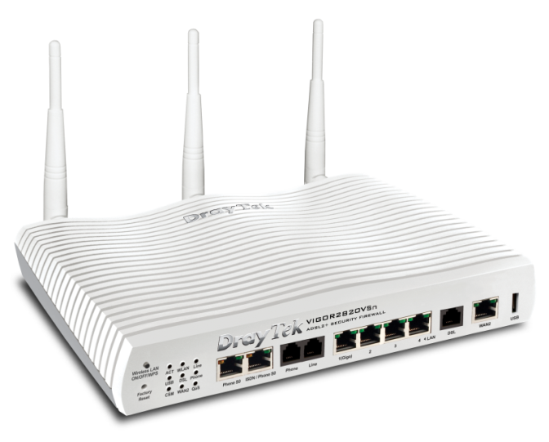
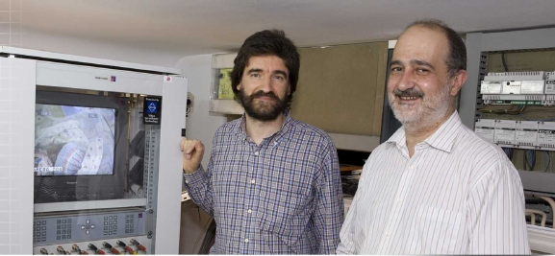
Babycare Project of Portugal Telecom
The high-level care of early born babies in hospitals
Vigor2820 series
Notes:
22
22

Slide 23
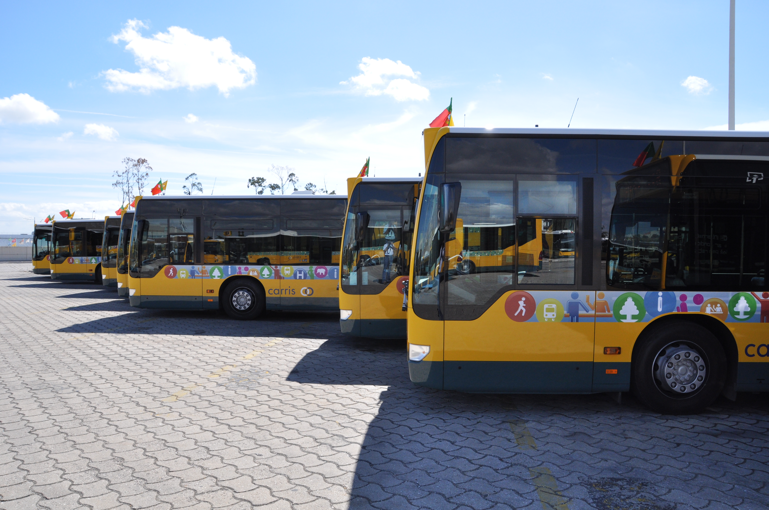
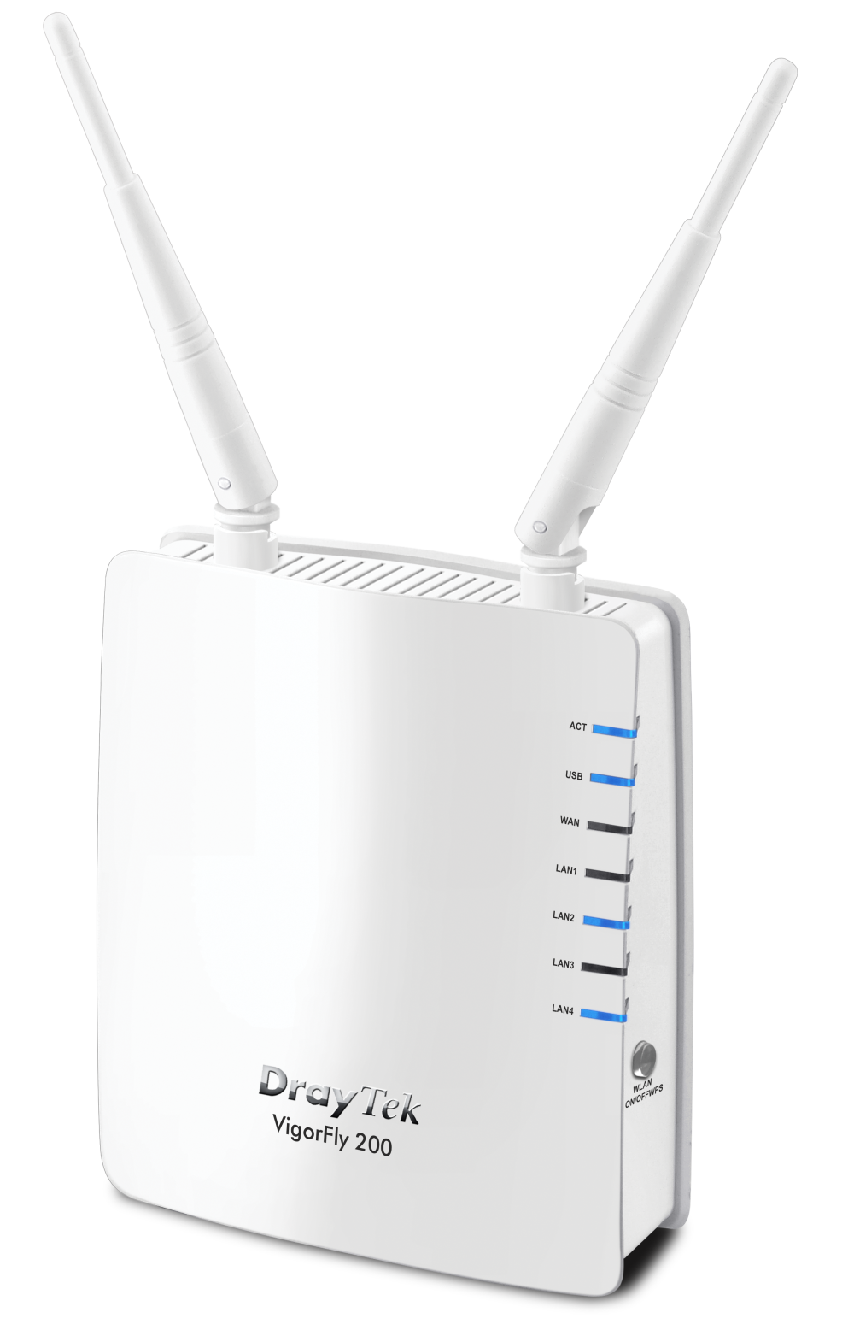
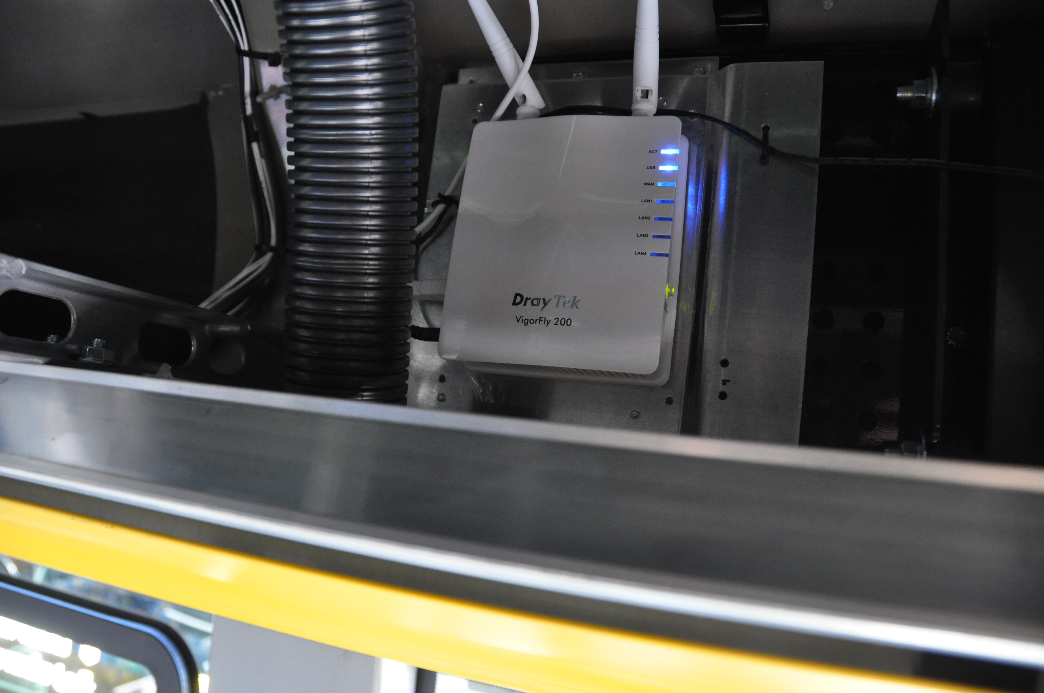
Free Broadband Access –
Carris Net Bus with VigorFly200
Notes:
23
23

Slide 24


Segrate Village in Italy & Vigor2110Vn
Ethernet home solutions
Notes:
24
24

Slide 25

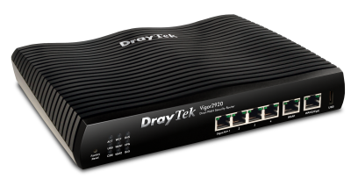
USA Small Net Builder
Highly-recommended Vigor2920
The original review in Small Net Builder
http://www.smallnetbuilder.com/lanwan/lanwan-reviews/31354-draytek-vigor-2920-reviewed
Notes:
25
25
25

Slide 26
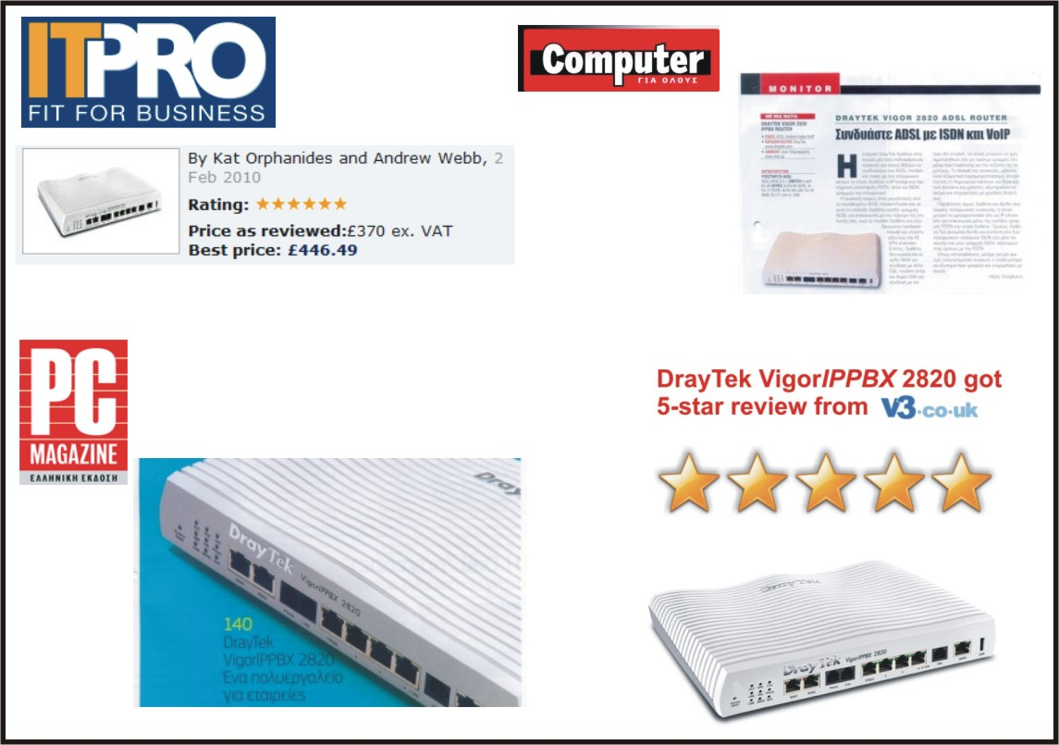
DrayTek Highly Recommend : VigorIPPBX 2820
For Small & Mid size business solution
Notes:
26
26
26

Slide 27

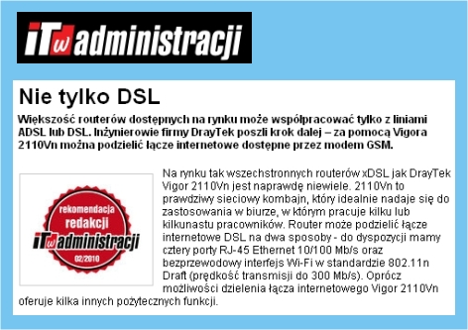
DrayTek Vigor2110 series win multiple recommendations in the world
Italy
Poland

Slide 28
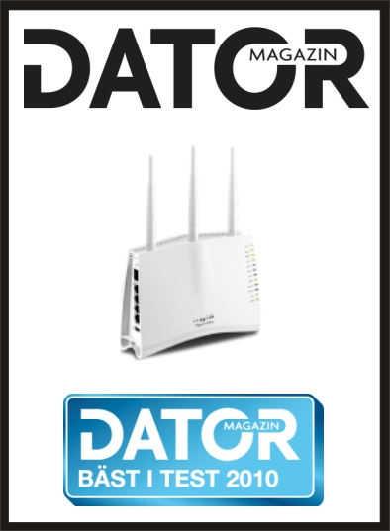
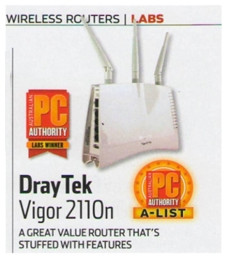
DrayTek Vigor2110 series win multiple recommendations in the world
AUSTRALIA
SWEDEN
Vigo2110n: The LABS WINNER & A-LIST of PC AUTHORITY

Slide 29


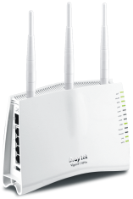

DrayTek Vigor2110 series win multiple recommendations in the world
UK
Portugal
Israel

Slide 30

Notes:
30
30
30

Slide 31
3. Product Roadmap

Slide 32
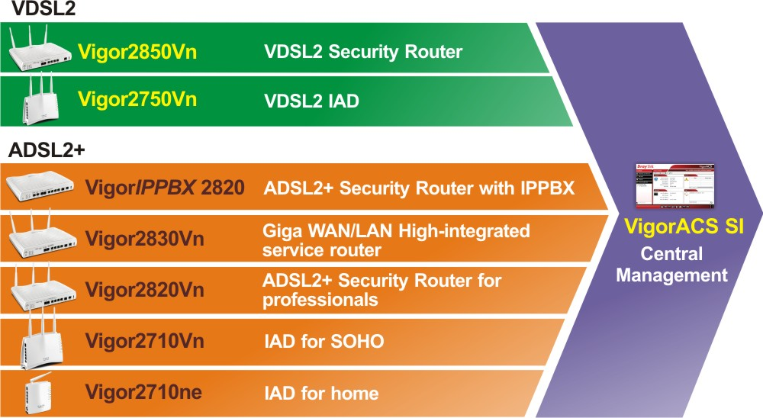
DrayTek Solutions for xDSL

Slide 33
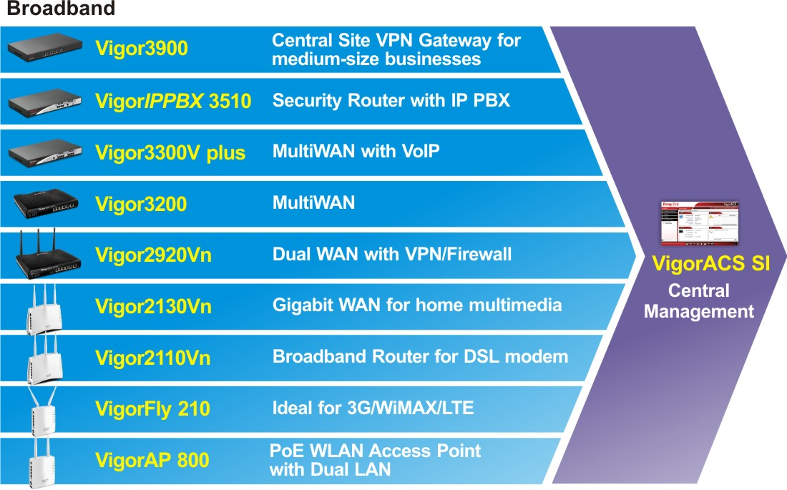
DrayTek Solutions for Broadband

Slide 34

DrayTek IPv6 Ready Announcement
DrayOS Platform
Model Name | Operation System | IPv6 | Firmware Version | Firmware Release Time | Mass Production | Remark
Vigor2850 series | DrayOS 2011 | V | 3.6.0 | Q4, 2011 | V
Vigor2830 series | DrayOS 2011 | V | 3.6.0 | Q4, 2011 | V
Vigor2920 series | DrayOS 2011 | V | 3.6.0 | Q4, 2011 | V
Vigor3200 series | DrayOS 2011 | V | 3.6.0 | Q4, 2011 | V
Vigor2710 series | DrayOS 2011 | V | 3.6.0 | Q1, 2012 | V | Vigor2710e/ne excluded
Vigor2110 series | DrayOS 2011 | V | 3.6.0 | Q1, 2012 | V
Notes:
34

Slide 35
DrayTek IPv6 Ready Announcement
Linux Platform
Model Name | Operation System | IPv6 | Firmware Version | Firmware Release Time | Mass Production | Remark
Vigor2130 series | Linux | V | 1.3.0 | Q1, 2011 | V
Vigor2750 series | Linux | V | 1.3.0 | Q1, 2011 | V
Vigor2760 series | Linux | V | MP version | Q1, 2012 | Q1, 2012
Vigor2860 series | Linux | V | MP version | Q1, 2012 | Q1, 2012
Vigor2960 series | Linux | V | MP version | Q4, 2011 | Q4, 2011
Vigor3900 series | Linux | V | 1.0.4 | Q4, 2011 | Oct, 2011 | MP version : 1.0.5
VigorFly210 series | Linux | V | 1.1.0 | Q4, 2011 | Q4, 2011
Notes:
35

Slide 36
4. Residential / SOHO Solutions

Slide 37
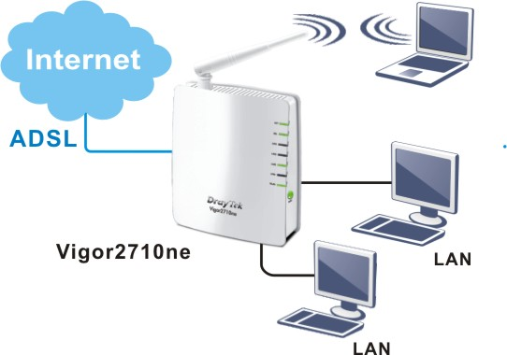
Residential
Vigor2710ne
vigorFly200
vigor2130Vn
vigorAP800
vigor2710VDn
vigor2110Vn
Residential
Connect and share ADSL Internet Directly
Notes:
37

Slide 38
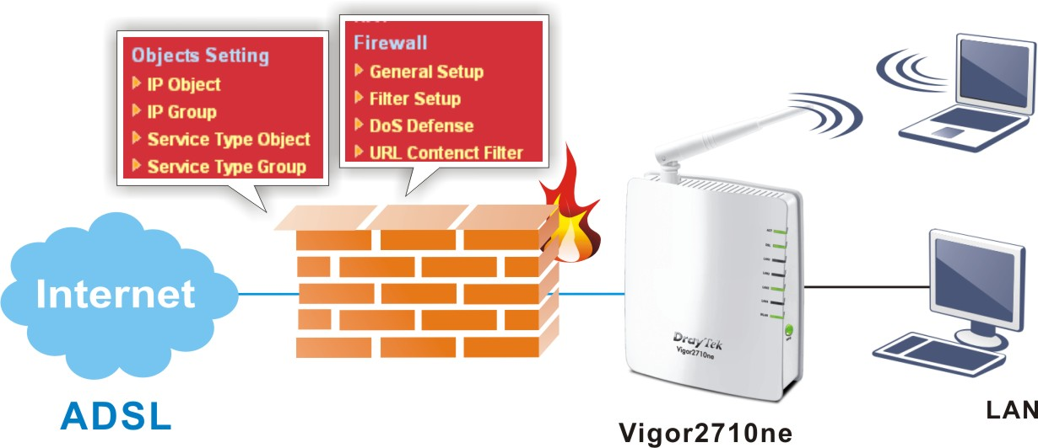
Residential
Vigor2710ne
vigorFly200
vigor2130Vn
vigorAP800
vigor2710VDn
vigor2110Vn
ADSL2/2+
Parental Control by Firewall
Notes:
Re-do
38

Slide 39
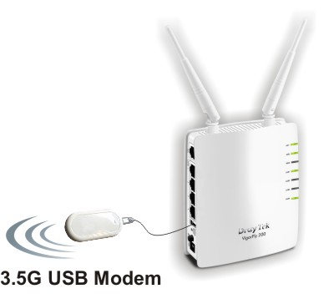
Residential
VigorFly200
vigor2710ne
vigor2130Vn
vigorAP800
vigor2710VDn
vigor2110Vn
Broadband
Support Varieties of 3.5G USB Moden
Note:
The world-wide FIRST router supports 3G / 4G / WiMAX / LTE USB mobile
Notes:
Role model: 2700
39

Slide 40
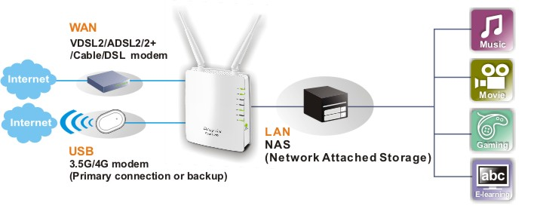
Residential
VigorFly200
vigor2710ne
vigor2130Vn
vigorAP800
vigor2710VDn
vigor2110Vn
Broadband
Enjoy The Speedy Multimedia Streaming
Notes:
Role model: 2700
40

Slide 41





Residential
Vigor2130Vn
vigor2710ne
vigorFly200
vigorAP800
vigor2710VDn
vigor2110Vn
Broadband
Product Highlights
Provides Unprecedented Speeds on Fiber Broadband Network
IP Version : IPv4 / IPv6
High Speed Gigabit Router
Up to 800 Mbps Downstream / Upstream
Easy-to-use Firewall and Secure VPN
Compatible with Euro-DOCSIS 3.0 & DOCSIS 3.0
VoIP facilities for low cost calls (Vn model)
Notes:
41

Slide 42

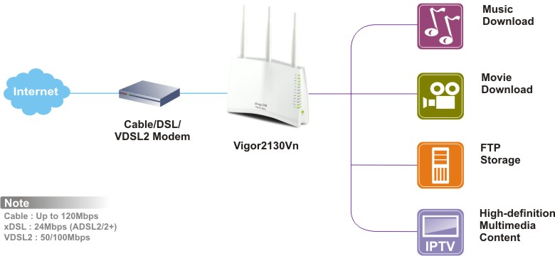


Residential
Vigor2130Vn
vigor2710ne
vigorFly200
vigorAP800
vigor2710VDn
vigor2110Vn
Broadband
Gigabit WAN/LAN for P2P Downloading / Gaming
Notes:
42
42

Slide 43
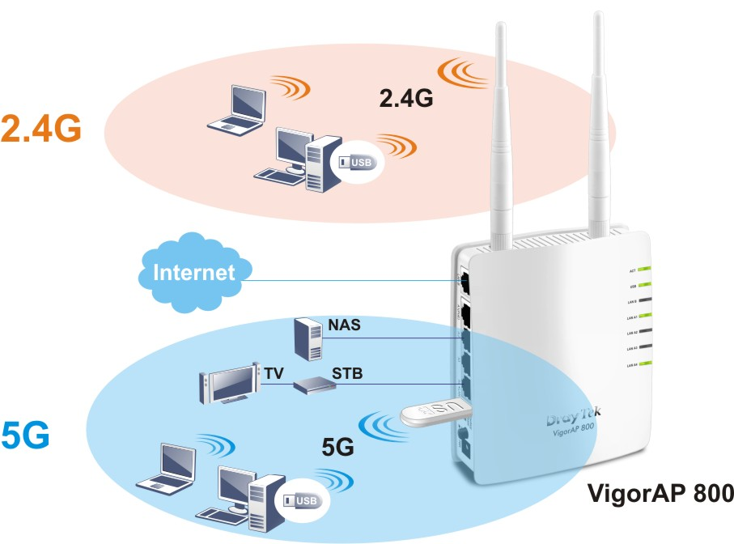
Residential
VigorAP800
vigor2710ne
vigorFly200
vigor2130Vn
vigor2710VDn
vigor2110Vn
Access Point
Support Simultaneous Dual Band Wireless Access
Main Feature:
Wireless AP with 1 PoE port
2 sub-nets
2.4G : 1st sub-net for data
5 G : 2nd sub-net for media
TR-069
1 x USB port to connect specified 5GHz
wireless dongle to support simultaneous
dual band wireless access.
Radius Server
802.1x tag VLAN

Slide 44
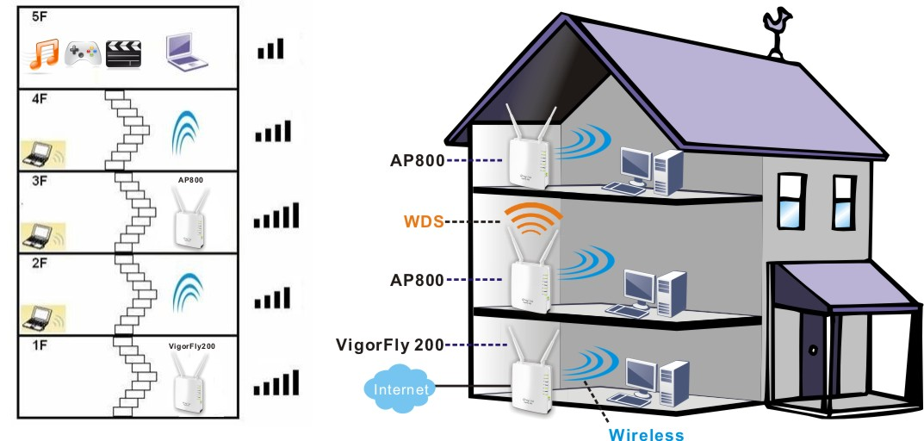
Residential
VigorAP800
vigor2710ne
vigorFly200
vigor2130Vn
vigor2710VDn
vigor2110Vn
Access Point
Freedom for Roaming for Home Users
Notes:
Role model: 2700
44

Slide 45
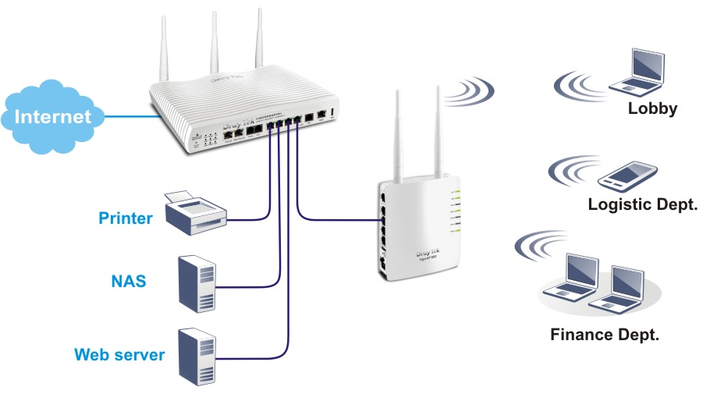
Residential
VigorAP800
vigor2710ne
vigorFly200
vigor2130Vn
vigor2710VDn
vigor2110Vn
Case Study 1
Exchange Data Between Wired & Wireless Devices for Office
Notes:
45

Slide 46
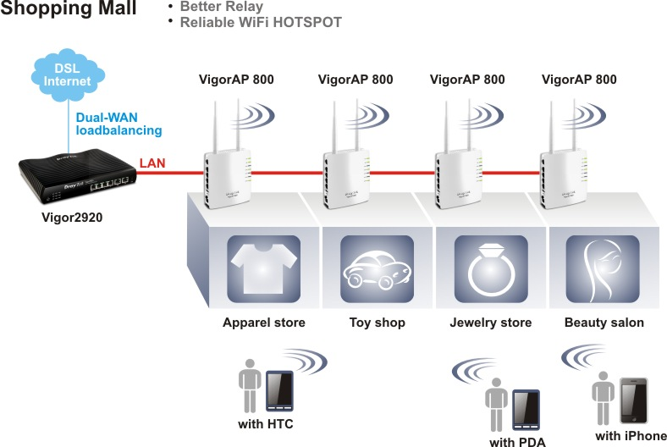
Residential
VigorAP800
vigor2710ne
vigorFly200
vigor2130Vn
vigor2710VDn
vigor2110Vn
Case Study 2
Extendable Coverage for WiFi Hot Spot for Shopping Mall
Notes:
46

Slide 47

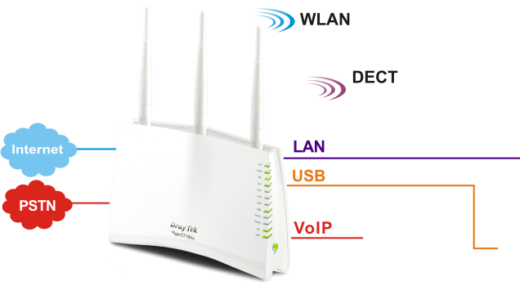




SOHO
Vigor2710VDn
vigor2710ne
vigorFly200
vigor2130Vn
vigorAP800
vigor2110Vn
ADSL2/2+
Run Your Home Office / Advanced IAD
Vigor2710VDn
Notes:
47
47

Slide 48
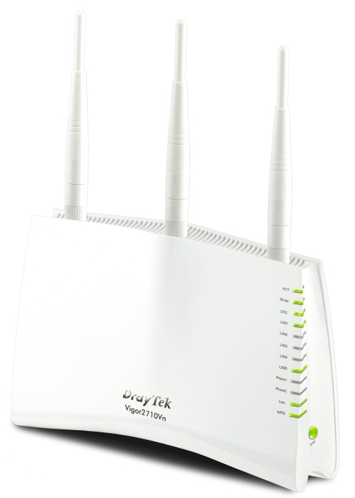

SOHO
Vigor2710VDn
vigor2710ne
vigorFly200
vigor2130Vn
vigorAP800
vigor2110Vn
ADSL2/2+
Productivity Enhancement by Commtouch
Notes:
Re-do
48

Slide 49
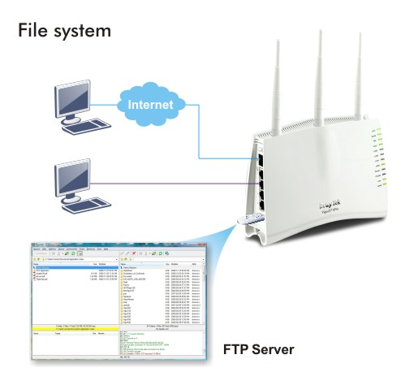




SOHO
Vigor2110Vn
vigor2710ne
vigorFly200
vigor2130Vn
vigorAP800
vigor2710VDn
Broadband
USB Application / File sharing
Notes:
49
49

Slide 50
5. SMB Networking Solutions

Slide 51
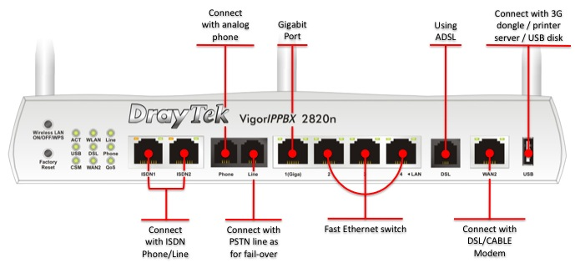
SMB
VigorIPPBX 2820
vigor2820Vn
vigor2830Vn
vigor2750Vn
vigor2920Vn
Application
ADSL2/2+
IP Telephony for SMB
Notes:
51
51

Slide 52
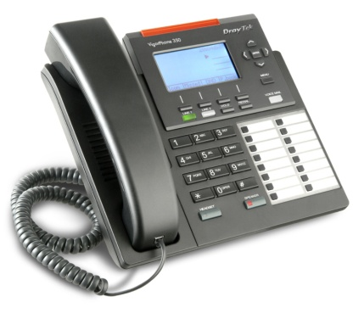
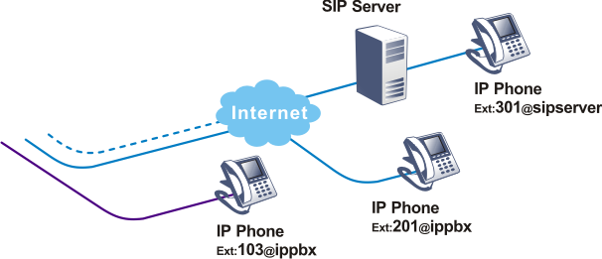
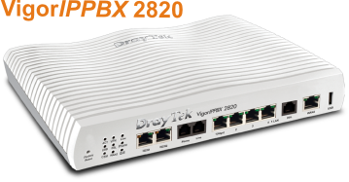
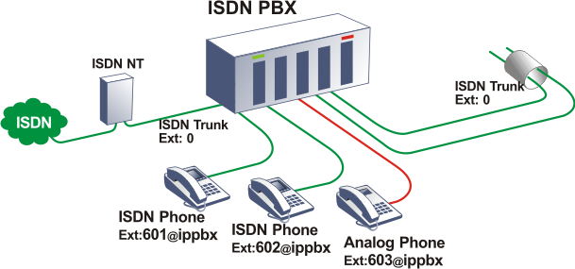

SMB
VigorIPPBX 2820
vigor2820Vn
vigor2830Vn
vigor2750Vn
vigor2920Vn
Application
ADSL2/2+
VigorIPPBX 2820 + VigorPhone350
PoE support
Auto Provision
G.722 for crystal voice
Multiple SIP registration
BLF ( Busy-Lamp Field)
Notes:
52
52

Slide 53







SMB
Vigor2820Vn
vigorIPPBX 2820
vigor2830Vn
vigor2750Vn
vigor2920Vn
Application
ADSL2/2+
Satisfied Your needs by All-in-one Wireless Router
On
One device
Two WAN ports
Three ways to access the Internet
(ADSL2+ / Broadband / 3.5G)
Four modules for management
(IM management / Content filter
Bandwidth control / Object management)
Five major functions
(VoIP / 11n / VPN / QoS / Firewall)
Six Star design

Slide 54













SMB
Vigor2820Vn
vigorIPPBX 2820
vigor2830Vn
vigor2750Vn
vigor2920Vn
Application
ADSL2/2+
Secure VoIP ZRTP Scenario for VIP
Secure
VoIP Call
Notes:
54
54

Slide 55

SMB
Vigor2830Vn
vigorIPPBX 2820
vigor2820Vn
vigor2750Vn
vigor2920Vn
Application
ADSL2/2+
Front Panel Description
Notes:
55
55

Slide 56


SMB
Vigor2830Vn
vigorIPPBX 2820
vigor2820Vn
vigor2750Vn
vigor2920Vn
Application
ADSL2/2+
Gigabit WAN/LAN for SMB
Notes:
56
56

Slide 57

SMB
Vigor2830Vn
vigorIPPBX 2820
vigor2820Vn
vigor2750Vn
vigor2920Vn
Application
Wireless
Dual Band Wireless Supported Model (2.4G/5G)
Selectable
Vigor 2830 series / Vigor 2750 series
Simultaneous
Vigor AP800 (by plugging a wireless USB dongle)

Slide 58
SMB
Vigor2830Vn
vigorIPPBX 2820
vigor2820Vn
vigor2750Vn
vigor2920Vn
Application
Comparison
Vigor2830 series Vs Vigor2820 series
Difference | Vigor2830 Series (Single/Dual) | Vigor2820 Series
LAN switch | 4 Gigabit Ports | 1 Gigabit port, 3 *10/100BaseTX
WAN | 1 Gigabit Ethernet Port | 1 10/100 Base TX Port
 | 1 DSL Port | 1 DSL Port
 | 1 USB Port for USB mobile | 1 USB port for USB mobile
Network Feature | Multi-subnets | None
WLAN | Selectable 2.4/5 GHz frequency | 2.4GHz frequency
Available Models | Vigor2830 Vigor2830n Vigor2830Vn | Vigor2820
 |  | Vigor2820n
 |  | Vigor2820Vn
 |  | Vigor2820VSn
[1] Difference V2830_V2820
Notes:
58
58

Slide 59

SMB
Vigor2750Vn
vigorIPPBX 2820
vigor2820Vn
vigor2830Vn
vigor2920Vn
Application
VDSL2
Multi-VLAN Application
Notes:
59

Slide 60

SMB
Vigor2920Vn
vigorIPPBX 2820
vigor2820Vn
vigor2830Vn
vigor2750Vn
Application
Broadband
Gigabit WAN/LAN for SMB
Notes:
60

Slide 61

SMB
Application
vigorIPPBX 2820
vigor2820Vn
vigor2830Vn
vigor2750Vn
vigor2920Vn
VPN
Connecting with Branches and Teleworkers
Notes:
61

Slide 62
6. Enterprise Networking Solutions

Slide 63

Enterprise
Vigor 3200
VigorIPPBX 3510
Vigor 3900
Application
Interface
Front Panel Description / Gigabit WAN/LAN
Notes:
63

Slide 64

Enterprise
Vigor 3200
VigorIPPBX 3510
Vigor 3900
Application
Broadband
Four WAN Ports for Internet Access
Notes:
64

Slide 65





Enterprise
VigorIPPBX 3510
Vigor 3200
Vigor 3900
Application
Interface
Optional FXS / FXO / ISDN Modules
FXS / FXO / ISDN
Notes:
65
For utmost reliability, VigorIPPBX 3510 also has “Fallback via PSTN”
Even during the entire Internet downtime from chosen ITSPs, VigorIPPBX 3510’s PSTN modules keep the call network stay connected.
65

Slide 66


Enterprise
VigorIPPBX 3510
Vigor 3200
Vigor 3900
Application
Internal Calls
Consolidating Management for All Extensions
Notes:
66
For internal calls, VigorIPPBX 3510 can consolidate management for all extensions even not at the same country.
For example,
One company’s HQ is located in Stratham NH and has one factory in China. (I didn’t say it must be Timberland)
Through registered all extensions at VigorIPPBX 3510, logistical manager in HQ can call the produce line leader in China to check the status of the next season model, just like they are at the same physical location.
66

Slide 67


Enterprise
Vigor 3900
Vigor3200
VigorIPPBX 3510
Application
Central MGMT
Multi-WAN Security Appliance
500 VPN Tunnels
Multiple Subnets
Virtual System
Port Base VLAN: 802.11 VLAN tagging
QoS/Load Balance
Firewall
High Availability
TR-069*

Slide 68

Enterprise
Application
Vigor3200
VigorIPPBX 3510
Vigor3900
VPN
Central Site VPN Gateway
Notes:
68

Slide 69
7. Network Management System

Slide 70

ACS SI - System Architecture
With TR-069 protocol, VigorACS SI can easily communicate and manage devices.

Slide 71

ACS SI – Gain More Than We Thought
Investment
  License Fee of VigorACS SI
  Service Fee of VigorACS SI
  (customization, maintenance, troubleshooting and training)
Return
  Reduce installation cost
  Reduce service cost
  Customer’s satisfaction (Priceless)

Slide 72

ACS SI - Main Features Introduction
    Device Management
    System Alarm and Log Management
    Network Topology Management
    Performance Management
    User Management
    Wizards and Auto Provision
    Multilingual and Reports

Slide 73

Q & A
Your reliable networking solutions partner

