Slide 1
HDV over IP System Solution
HDMI Extender over IP
HDMI, DVI, VGA K.V. M Extender over IP
Smart Cabling & Transmission Corp.

Slide 2
HDV over IP (HDMI/DVI/VGA or KVM over IP)
Features：
Send and distribute HDMI 1080p signal over LAN ( not support 3D, 4k2k)
Use IGMP and 8K Jumbo frame packets Gigabit Switch Hub to do HD signal distribution and transmission.
Expandable, the Hub location can easily add Transmitter or Receiver if the network bandwidth is enough (TX * 16 pcs; RX: over 254 pieces ).
Support HDMI , DVI, VGA different interface, all could be mixable.
Support USB Keyboard /Mouse , HDMI (HKM01B) / VGA (VKM03B)/ DVI (DKM01B),
Support Bi-Directional RS232, IR, analog audio.
As a Matrix, distributor , switcher system.
Perfect for large scale remote HD content access and security monitoring systems, digital signage applications.

Slide 3

System Control 1 : Remote Control ( Each Receiver)
Source side, setup the channel(0-15)
Remote Side, using remote control
select the input source (number+enter)

Slide 4
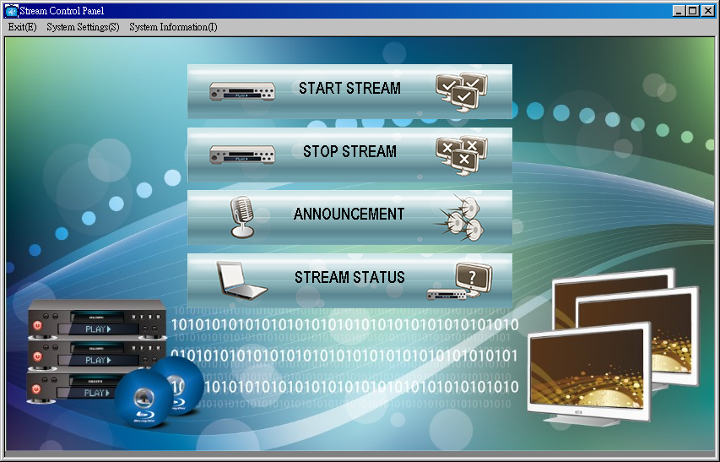
System Control 2: Software Windows base
1 Start Stream 2 Stop Stream 3 Announcement 4 Stream status

Slide 5
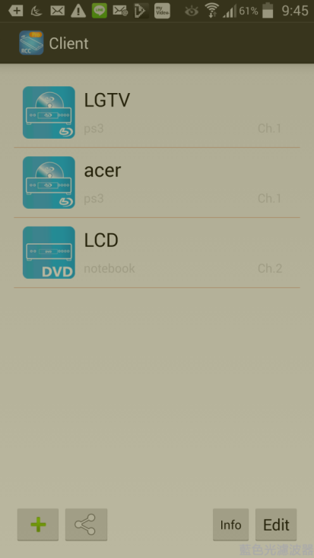
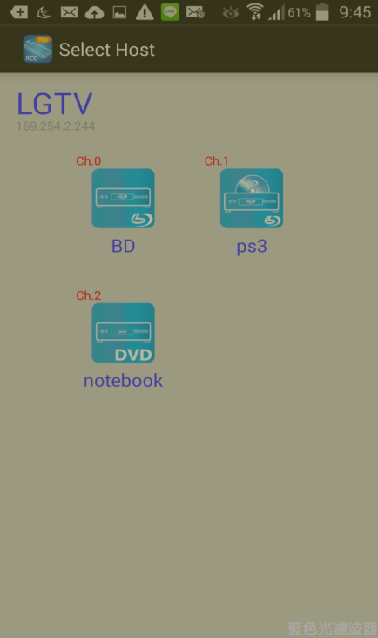
System Control 3 : Android /Iphone Mobile phone/Pad
Client : Output monitor
Host : Input Source Device

Slide 6
System Features：
To send HD signal for extra longer distance go through Hub (with Fiber optic port)
Support point to point and 1 input to Multiple output, or multiple source devices to multi-display connections via Gigabit network switch.
RS232 built in distribution function, to send RS232 signal from one TX to multiple RX. When Remote Control by RS232 commands, it could control TX / RX channel selection and do group management functions to control the screen / projector (power on/off, mute..etc) with RS232 interface.
If the monitor not support RS232 interface, to add on our optional model: “Programmable IR module” to receive RS232 commands and do control the monitors for power on/off, mute…etc.

Slide 7
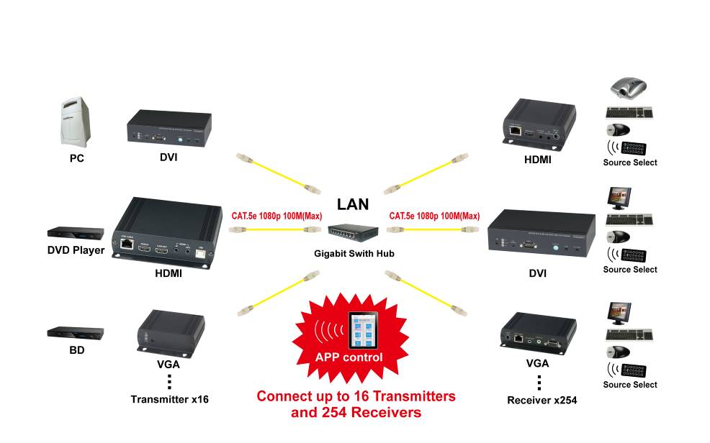
HDV System Configuration
HDMI, DVI, VGA, KVM MATRIX over IP

Slide 8
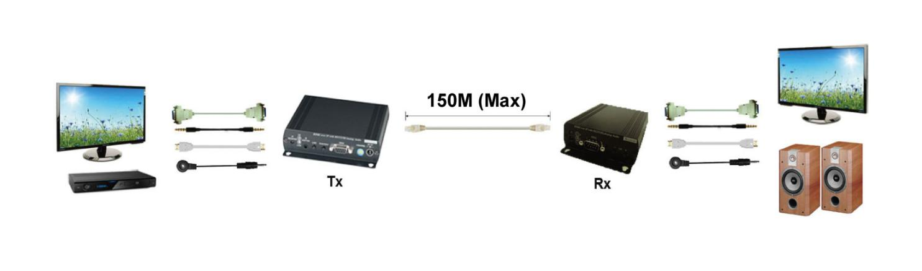
Extender 150M : Point to Point

Slide 9
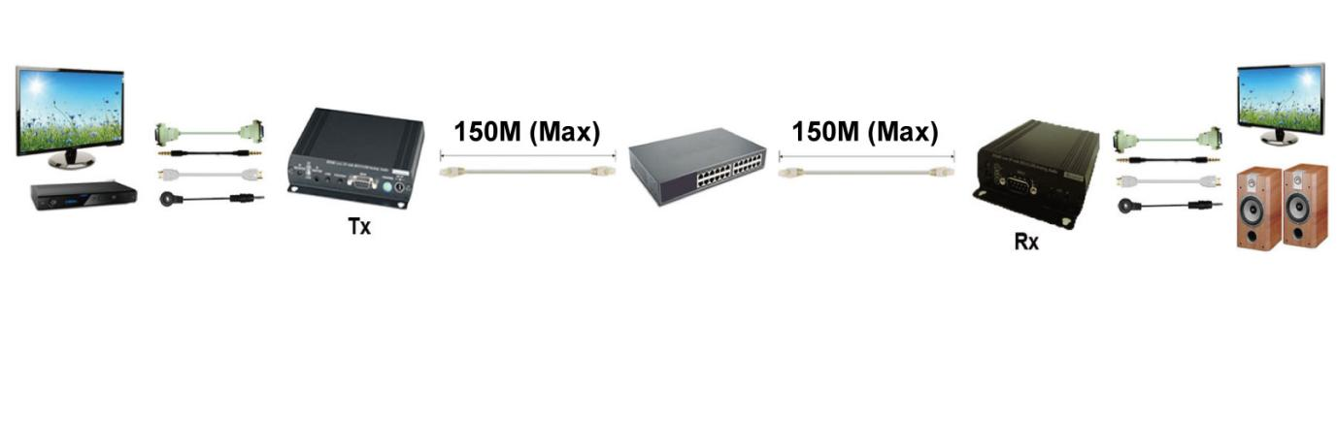
Extender over LAN: Point to Point With HUB

Slide 10
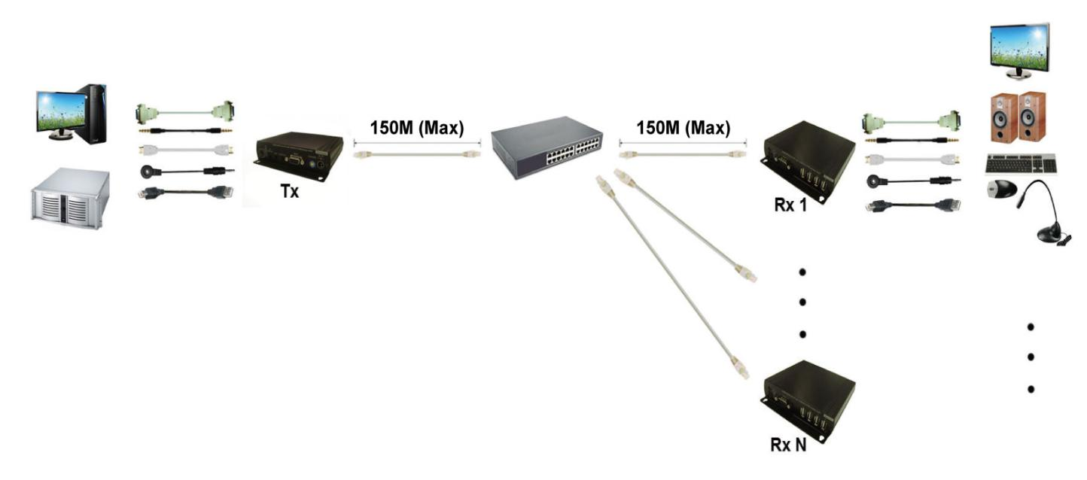
Splitter over LAN: One TX to Multi RX

Slide 11
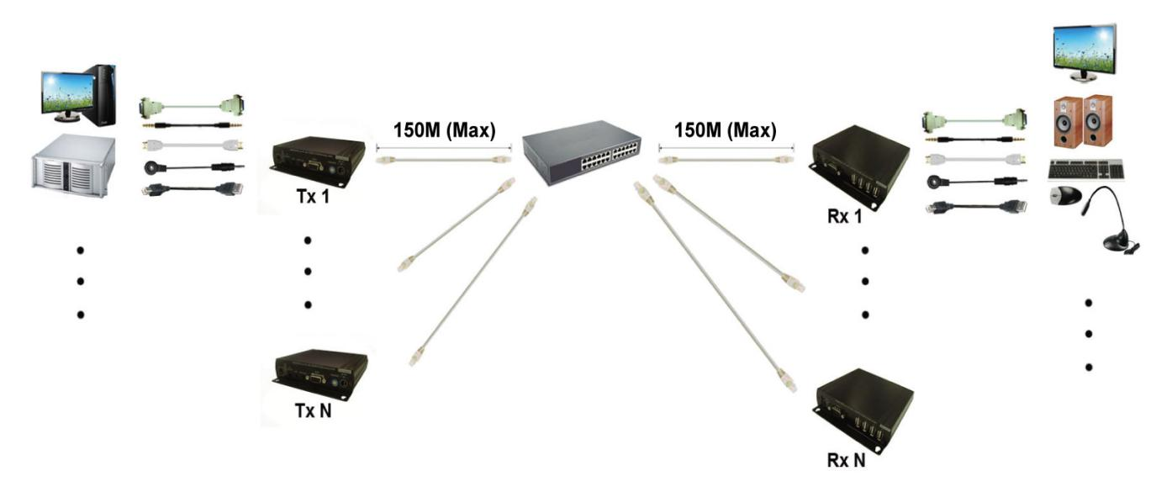
Matrix Switcher over IP: Multiple TX to Multiple RX

Slide 12
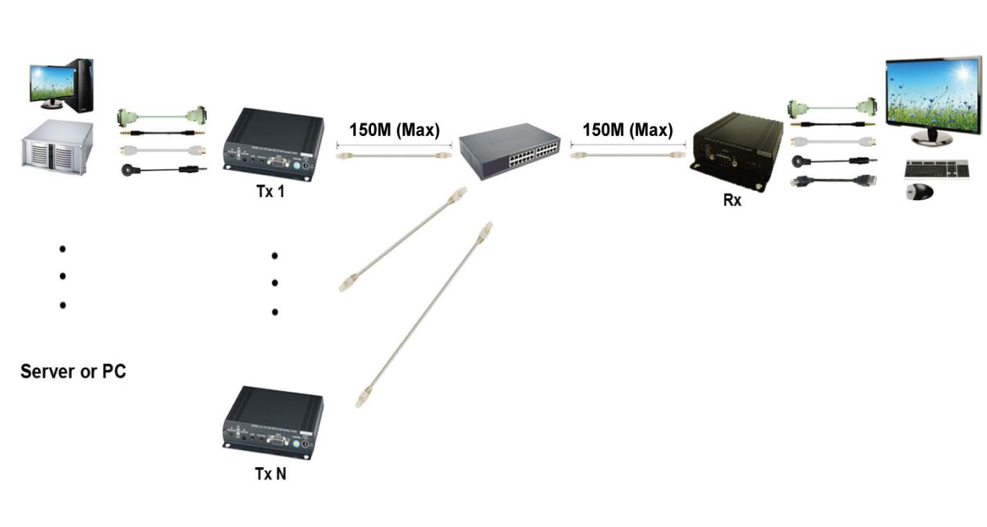
KVM Switcher over IP : Multiplex TX to One RX

Slide 13
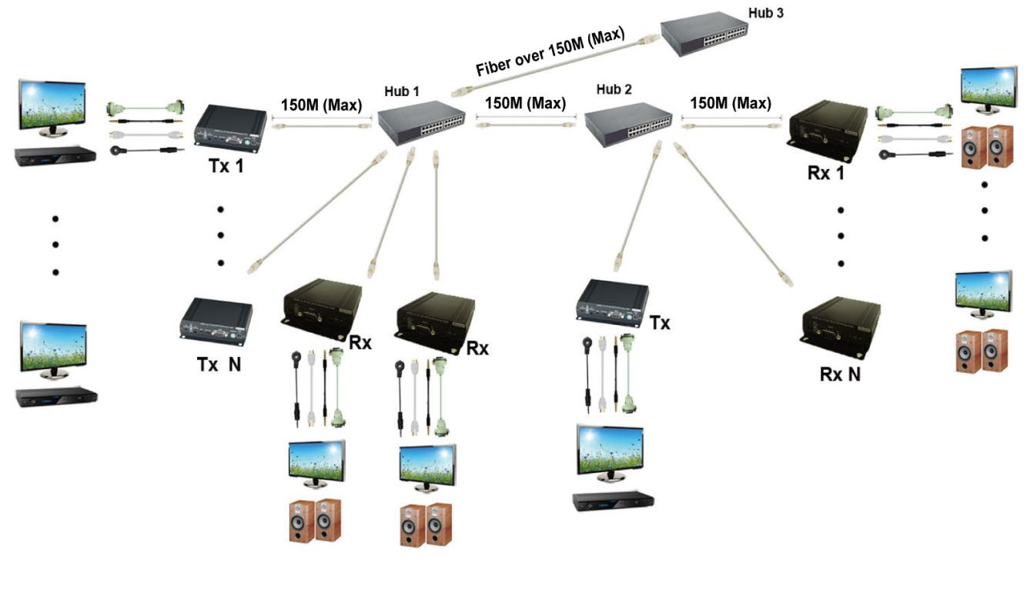
Multiple KVM Control over IP: Multiplex TX to Multiple RX with multiple Hub

Slide 14
ITEM NO | Function
HE05BT | TX |  | HDMI | 1080P | IR Extender | RS232 |  | Audio
HKM01BT | TX |  | HDMI | 1080P | IR Extender | RS232 | USB | Audio
DKM01BT | TX |  | DVI | 1080P | IR Extender | RS232 | USB
VKM03BT | TX |  | VGA | 1920x1200 | IR Extender | RS232 | USB | Audio
HE05BR |  | RX | HDMI | 1080P | IR Extender | RS232 |  | Audio
HE05BER |  | RX | HDMI | 1080P
HKM01BR |  | RX | HDMI | 1080P | IR Extender | RS232 | USB | Audio
VDKM01BR |  | RX | VGA+DVI | 1920x1200 | IR Extender | RS232 | USB | Audio

Slide 15
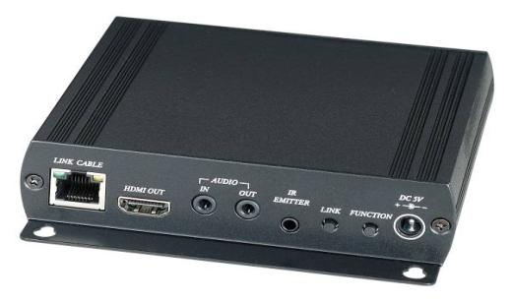
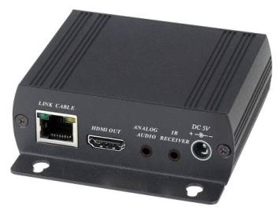
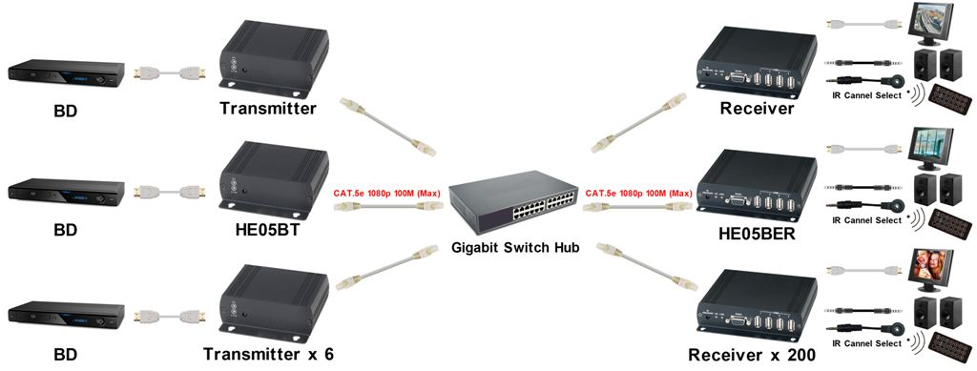
HE05BT,
HE05BER,
package include a VESA mounting bracket to fix it at monitor back side

Slide 16
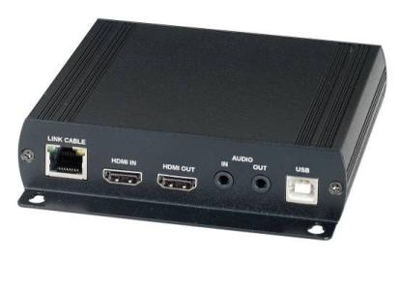
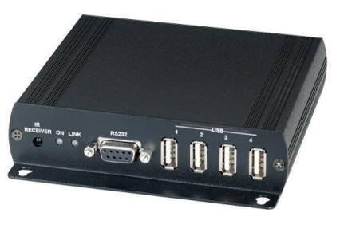
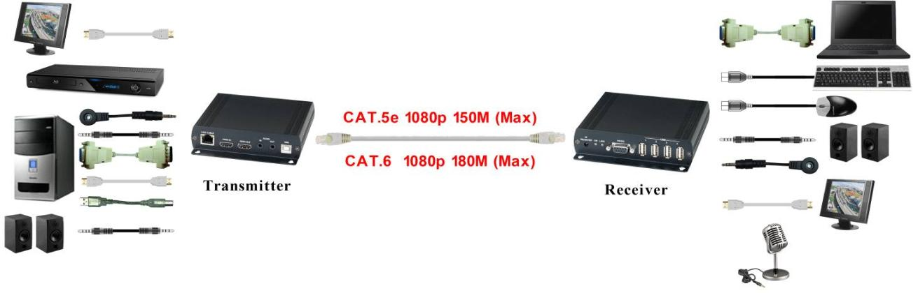
HKM01BT
w/USB K/M
HKM01BR
w/USB K/M

Slide 17
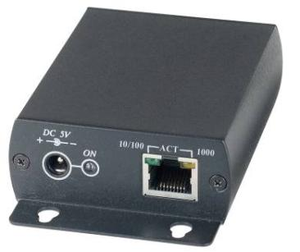



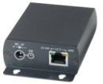



Optional Model--- SR01(LAN Repeater)
to extend IP signal over 100 meters.
CAT5100M
CAT5
100M
CAT5
100M
CAT5
100M
TX
RX
SR01
HUB
SR01

Slide 18
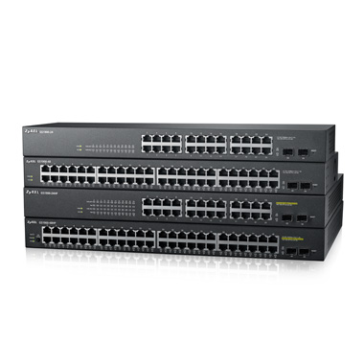
Giga Switch HUB : Must be support IGMP, 8K Jumbo frame

Slide 19
HDV over IP (HDMI/DVI/VGA or KVM over IP) Marketing
Audio Video :
Support Multiple video interface, Matrix/Expandable/long distance.
Easy LAN configuration, (Activated IGMP /same network segments/Bandwidth calculation)
IT or Security Monitoring :
K.V.M Control ( 1 Rx to Many Tx/ Many Rx to 1Tx/ Many Rx to Many Tx)
To combine the existing KVM Switch Server Room

Slide 20
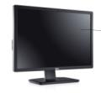



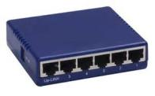





Server Room/Monitoring Host Application 2
( Multi Console Control without K.V.M Switch )
Server or DVR(pc base)
Gigabit HUB1
RX1
TX1
TX2
CATX100M
RX2
CATX100M
Gigabit HUB2
TX3
RX3
TX4
RX4

Slide 21
HDV System Demo
Equipments:
1. Source Device: BD (Channel 1) /
PS3 (Channel 2)/Notebook (Channel 3 )
2. Output Device:
TV (1080p)* 1 ; LCD display *2
3. Tx : HE05BT *2 / HKM01BT *1(include USB)
Rx: HE05BER*1/ HE05BR*1/ HKM01BR*1 (include USB)
4. Giga Switch 8 PORT Gigabit HUB *1 (support IGMP, 8K
jumbo frame)
5. Cable Cat5e 150M / HDMI Cable 3M

Slide 22
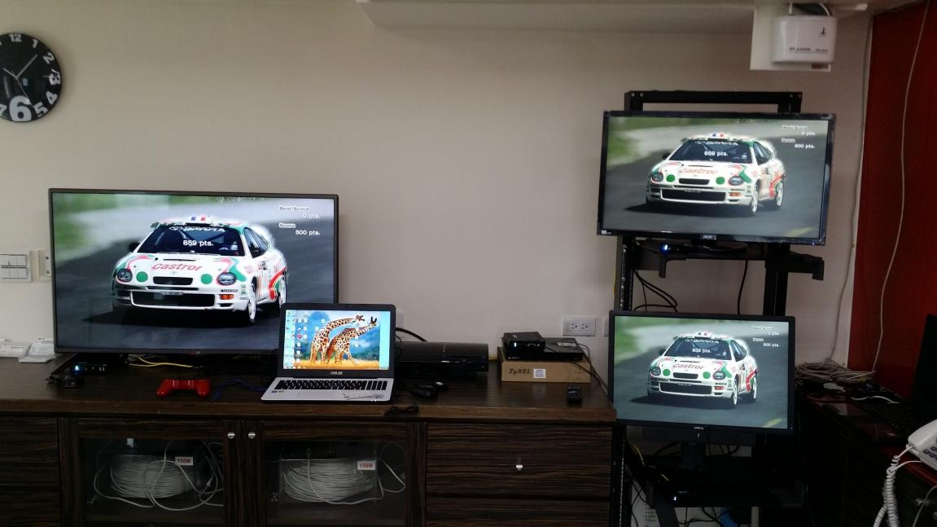
1080P 3 IN 3 OUT Video Application
For video demo , welcome go to below link
ftp://ftp.sct.com.tw/HDV%20over%20IP%20video%20file
/

Slide 23
Q & A
Q : Video resolution Support ?
A: 1080P
Q: Audio Support?
A: Yes
Q: Is there any video play lag issue?
A: No, the new chipset solution only need to work with Gigabit Switch Hub1 built in IGMP function and make sure it have been activated. Under allowable bandwidth condition, there won’t be any lag occurred.
.
Q: How many TX and RX?
A: The transmitter with rotary switch setting with max. 16 channel ( 0-15), receiver could be unlimited channels (work with HUB PORT).

Slide 24
Q & A
Ｑ：If TX(VGA) and RX (HDMI) with different interface, Could be direct connection without through HUB ?
Ａ：Yes
Q: UTP and FTP cable , different performance?
A: If the connection through HUB, the performance is same.
Q: At same zone, If multiple RX use IR remote control, the signal will be received at same time?
A: Yes, it is possible to received the IR signal at same time if the RX remote control within effective distance . (IR infra red/distance 5M/angle 55 degree)

Slide 25
Ｑ：Bandwidth Calculation？
Ａ：If Video resolution is 1080P, it would be around 100Ｍbit (Please refer to below resolution/bandwidth chart)
Others:
Caution: When Gigabit Hub1 series connection to Gigabit Hub2, the series bandwidth will be as 1 Gbps.
bandwidth 1Gbps
Gigabit Hub 1
Gigabit Hub2

Slide 26
Bandwidth Chart:
The bandwidth will be varied based on different resolution. Higher resolution may not request bigger bandwidth.
Below Chart is the resolution and bandwidth status for reference.
Resolution (@60Hz) | Average Bandwidth (Mbps)
1080p | 77 (24 ~ 91)
720p | 46 (29 ~ 150)
480p | 63 (36 ~ 73)
1600x1200 (UXGA) | 59 (24 ~ 73)
1280x1024 (SXGA) | 58 (31 ~ 76)
1024x768 (XGA) | 118 (56 ~ 138)
800x600 (SVGA) | 83 (64 ~ 107)

Slide 27
End

